Slide 1
Analogue Digital Converters (ADCs) and Random Numbers
PHYS3112 – Tutorial 6

Slide 2
In This Tutorial You Will:
Learn what an Analogue to Digital Converter (ADC) is and why they are necessary
Understand the concept of bit depth and input range, and how they affect the quality of your ADC
Use a rudimentary ADC (and build your own!)

Slide 3
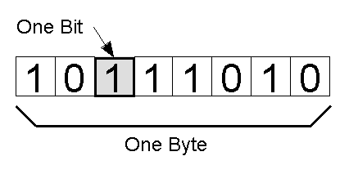
Why do we need ADCs?
Analogue signals exist as a continuous range
Digital signals (including when they’re stored) can only exist as digital, discrete values!
We need some protocol for converting an
Analogue signal into a digital one.

Slide 4
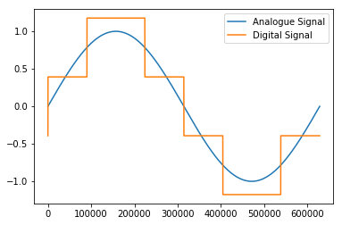
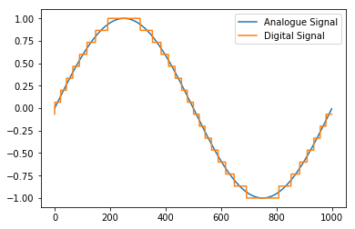
A Basic ADC
The analogue signal is discretised – it is broken up from a series of continuous values into a series of discrete values.
Each ‘real’ value is mapped to the closest possible digital value.

Slide 5
Bit Depth And Range
Bit Depth is the number of bits that are being used to encode the signal.
The total number of possible values is 2^(num_bits).
More bits = finer resolution!
Range is the range of values that the ADC will encode for
If the range is too small, high/low values will be cutoff
If the range is too large, you are wasting a lot of your levels
You need to match the range with the expected signal

Slide 6

Generating Random Numbers
‘Random’ numbers have to come from somewhere
Most pseudo-random number generators will generate random numbers using a highly unstable function
‘True Random’ numbers come from natural sources – there are a lot of sources out there (eg Cosmic Background Radiation)
But how much can be ‘truly random’ if the values are still influenced by our measurement apparatus?

Slide 7
Checking Random Numbers
.Zip it!
File compression works through identifying patterns – if your series of numbers are incompressible, then you have got a good random number generator
Go and write your own (or steal from Wikipedia), save the data and attempt to compress it. See how random you can get!
Michael’s notes on RNGs are super helpful (referenced in the tutorial notebook) and will probably be in the exam.

